Slide 1
Smart Safe IoT System
Team: Saif | Fares | Hassan | Abdelhamid | Abdulaziz

Slide 2
Project Overview
• Smart Safe controlled remotely using IoT
• ESP32 with sensors and servo motor
• MQTT communication via HiveMQ
• Supabase database backend
• React.js Web App
• AI Chatbot with LangChain + Gemini

Slide 3
Problem Statement
• Traditional safes lack remote monitoring
• No history of open/close events
• Required features:
- Secure authentication
- Remote control
- Real-time event logging

Slide 4
Tech Stack
• Hardware: ESP32, IR sensor, LDR, Servo, LCD, LEDs
• Communication: MQTT (HiveMQ Cloud)
• Backend: FastAPI, LangChain, Gemini API, Supabase
• Frontend: React.js
• Optional: Node-RED

Slide 5
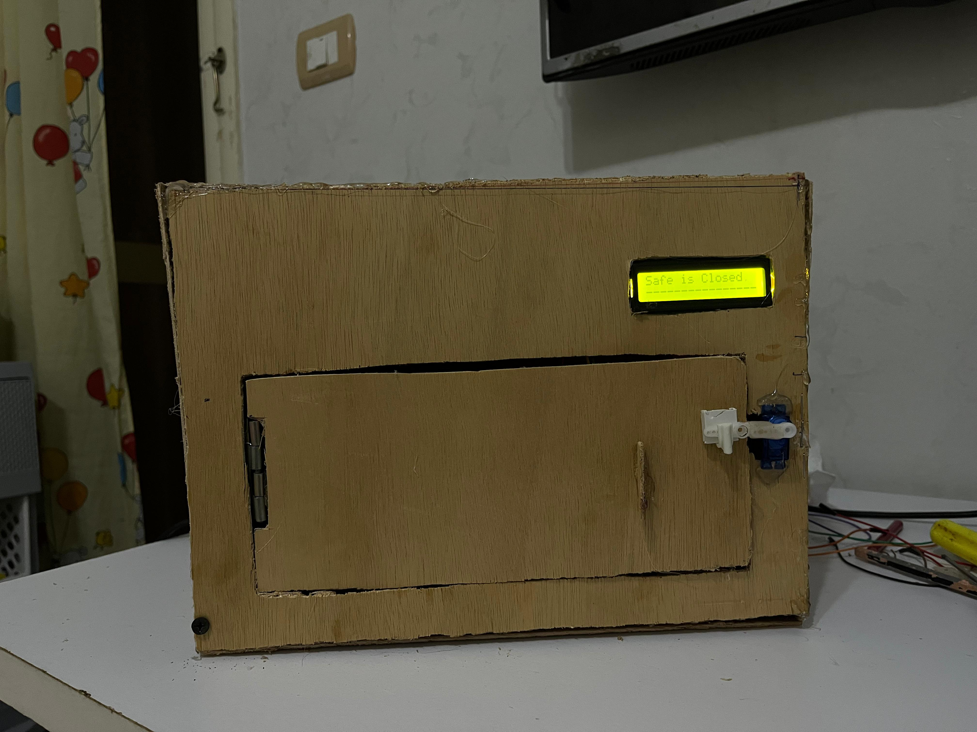
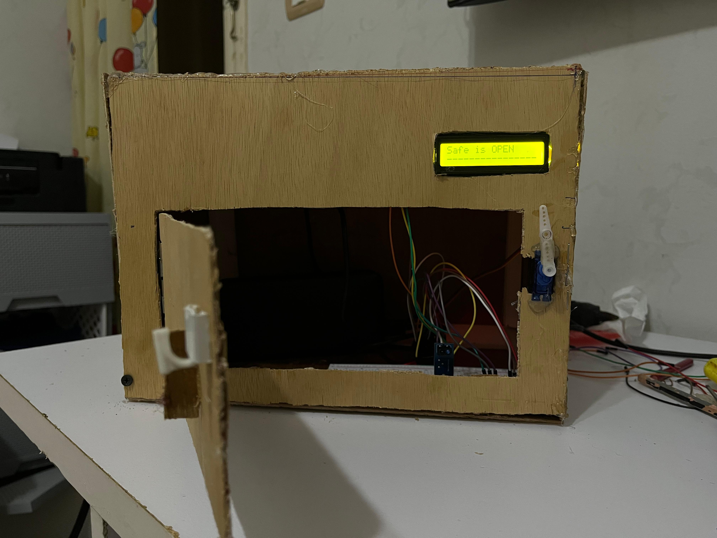
Sensors & Actuators
• IR Sensor → Detects safe door state
• LDR → Detects light, controls LEDs
• Servo Motor → Controls locking
• LCD → Displays 'Safe OPEN/CLOSED'
• LEDs → Indicate light/dark state

Slide 6
System Logic
1. User clicks 'Open Safe' → MQTT publishes command
2. ESP32 receives → opens servo, updates LCD
3. IR detects closing → ESP32 closes safe
4. LDR detects light → LEDs on/off
5. Status published back to broker

Slide 7
System Architecture
ESP32 (Sensors + Servo + LCD)
↓ MQTT Broker (HiveMQ)
↓ FastAPI + Supabase (Cloud)
↓ React.js Frontend
↓ LangChain Chatbot

Slide 8
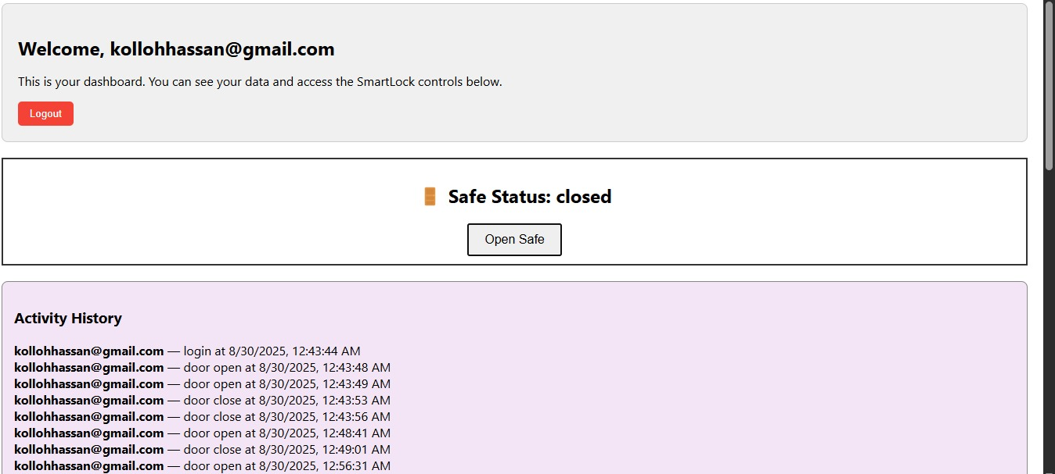
Outputs / Demo
• LCD → Safe status (OPEN/CLOSED)
• Web App → Login, Dashboard, Control
• History logs visible
• Chatbot answers event queries

Slide 9
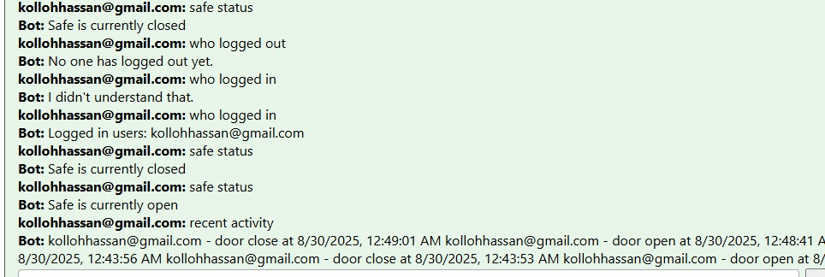
Challenges
• HiveMQ secure setup
• Supabase Auth + Policies
• FastAPI + LangChain integration
• Real-time sync across devices

Slide 10
Future Work
• Add Gas/Fire detection sensors
• SMS/Email notifications
• Mobile App (Flutter)
• AI predictive alerts

Slide 11
Saif – Hardware & ESP32
• Connected sensors + servo + LCD
• Programmed ESP32 with PlatformIO
• Managed MQTT commands
• Logic for open/close and LED lighting

Slide 12
Fares – Database
• Designed 4 tables (users, safe, safe_access, adding_to_safe)
• Functions: open_safe, close_safe, update_user, delete_user
• Supabase Auth with email/password
• Applied policies for team access

Slide 13
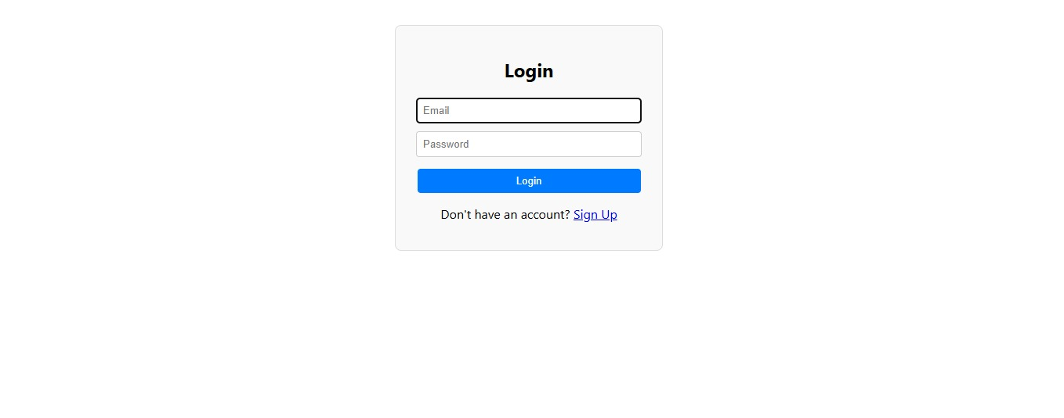
Hassan – Frontend
• Built React.js app (Login, Signup, Dashboard)
• DoorControl with MQTT pub/sub
• History logs UI
• ChatBot for querying events

Slide 14
Abdelhamid – FastAPI & Chatbot
• Built FastAPI backend
• Integrated LangChain + Gemini API
• Created /chat endpoint
• Linked MQTT to backend

Slide 15
Abdulaziz – MQTT & Cloud
• Configured HiveMQ broker
• Tested topics via MQTT Explorer
• Designed flows MQTT → Supabase / Web App
• Validated data storage

